Slide 1
School of Human Ecology
School of certain philosophy means a group of scholars believing or following the same way of thinking
H.H.Burrow, a geographer from Chicago university defined human geography as the science of Human ecology in early decades of 20th century.
Human ecology is the extension of the concept drawn from ecology to social realm.

Slide 2
As ecology deals with the relationship of organisms with their physical environment, human ecology studies the relationship of human being with their physical and social environment.
Both the determnism and possibilism try to separate environment from man, the central theme of human ecology is to study the reciprocal relationship between man and environment.
Man like plants and animals has to struggle in his physical environment and in the process of struggle weaker get eliminated

Slide 3
Burrow emphasized that human ecology should be used for man-environment relationship not in deterministic sense, but man’s place in the ‘web of life’
It’s main focus is human adjustment to surrounding environment.
According to International Organisation of Human ecology , it deals with Human life in all the physical, chemical, biotic, mental, social and cultural manifestations of human beings.

Slide 4
The advocates of Human Ecology believe that the ecological principles like food chain, food web etc. are all applicable in social realm.
Models of Human ecology:
Ecosystem Based Model- interaction among non living, plants and animals and human population
System Model- energy, material and information help functioning of social and biological system and their interaction.

Slide 5
Interaction oriented model- this model is ideal for studying human ecology in micro region. It takes into account the interaction between environmental and human factors.
Criticism-Human ecologists put man at par to plants and animals who is supposed to struggle in his environment. Man himself is the agent of transformation. Therefore, principle of human ecology is not applicable on human societies with the same magnitude as they are applicable on plants and animal world.

Slide 6
Landscape School
The term landscape was introduced into American geography by Carl O’ Sauer in 1925 with publication of book ‘Morphology of Landscape”. Sauer and his students established Berkeley school.
The landscape school seeks to describe man –environment relationship with primary focus on man impact on environment.
Under this view, the landscape is defined as an area made up of a distinct association of forms, both physical and cultural. These phenomena are not assorted, but associated.

Slide 7
Sauer studied the processes leading to landscape change of Red Indian society in America. He stressed that geographers should trace the development of a natural landscape into cultural landscape. This study involves-
General geography, Historical geography and Regional Geography. These branches of Geography study developmental sequence

Slide 8
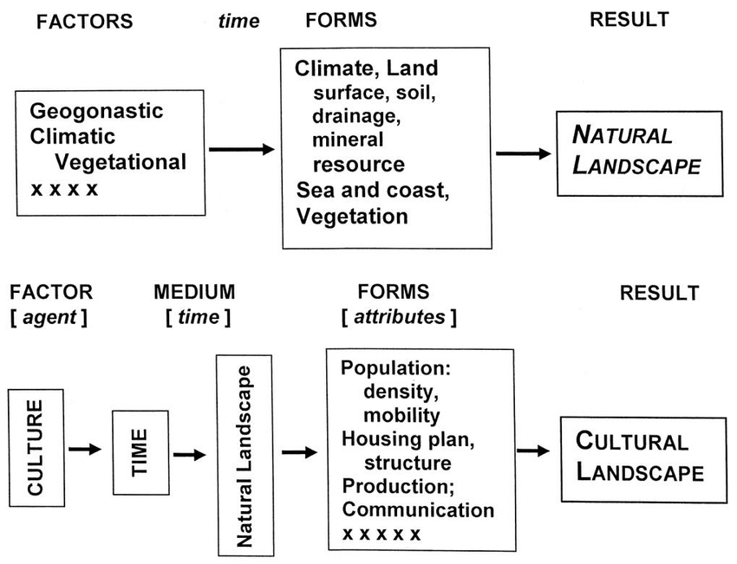
Sauer Model

Slide 9
The cultural landscape of a placed is shaped out of natural landscape by cultural group. The natural landscape is the result of environmental factors and culture is the agent, interaction between these two produce cultural landscape.
Criticism- it is seldom possible to reconstruct the appearance of natural landscape, because human impact on natural landscape has been pervasive for thousands of years. Besides there is lack of record regarding Historical background.

Slide 10
Locational school
After 1945, some scholars realized the significance of mathematical language rather than language of literature. therefore, the locational school tried to give geography a scientific look by adopting positivism approach.
Its principal motto was that knowledge on the basis of science is a valid knowledge.
This school defined geography as a spatial science.

Slide 11
The main objective of locational school was to build accurate generalisation, models and theories. This is the school that led to quantitative revolution in geography.
some geographers from locational school were –
Peter Haggett – Locational Analysis in Human Geography,1965(he appealed to adopt geometrical tradition to explain location order and pattern)
William Bunge- Theoretical Geography,1950(He said that geography is a science of location)

Slide 12
E.L.Ullman- A theory of location for cities (1945)
R.L.Morrill – Spatial Organization of Society,1970 ( he argued that people seek to maximize spatial interaction at minimum cost and bring related activities into proximity)
This school primarily stresses on----------
A)To adopt system approach which concentrates on pattern and linkages in spatial organization.

Slide 13
B) to employ models to understand man-environment relationship
C) to use quantitative techniques to make precise statement about locational order
Criticism- this school is criticized on philosophical and mathematical grounds by the Humanists group.
The locational analysis as based on positivism it ignores normative questions

Slide 14
So a quantitatively tested ideal location may not be acceptable to individuals or society. So there must be importance of qualitative study.
The models and theories developed with the help of locational analysis conceal the complexities of the real world.
This school is also criticized on the ground that it encourages capitalism

Slide 15
It is to be noted that in spite of all criticism against locational analysis, it substantially changed the nature of human geography that is able to develop precise and generalized statement of spatial organization.

Slide 16
AREAL DIFFERENTIATION
Areal Differentiation:
*Areal differentiation in geography refers to the study of how and why different regions of the Earth's surface vary from one another in terms of physical, cultural, economic, and environmental characteristics. It is a key concept in regional geography and focuses on understanding the uniqueness of places.
*The concept was emphasized by Richard Hartshorne, an American geographer, who argued that geography should focus on describing and explaining the differences between regions rather than finding universal laws.
*Richard Hartshorne, an American geographer, played a crucial role in defining areal differentiation as a central concept in geography. In his work, particularly in The Nature of Geography (1939), he emphasized that geography is primarily concerned with describing and analyzing the differences between places on Earth.

Slide 17
Hartshorne’s Views on Areal Differentiation:
Geography as a Science of Areal Differentiation
  Hartshorne argued that the primary task of geography is to study how different areas of the Earth’s surface vary from one another in terms of physical and human characteristics.
  He opposed the search for universal laws in geography, instead advocating for regional synthesis, where each region is studied in its own right.
Integration of Spatial Features
  He believed that geography should focus on how various physical and human features integrate to create unique regional characteristics.
  This approach differs from generalizations in other sciences, as geography emphasizes spatial relationships rather than universal principles

Slide 18
3. Historical Perspective in Areal Differentiation
  Hartshorne stressed that regional characteristics develop over time due to historical processes, and understanding these historical influences is essential in geographical studies.
4. Influence of German Geography
  His ideas were influenced by Alfred Hettner and German geographical traditions, particularly the idea that geography should describe spatial variations and regional uniqueness.
Criticism of Hartshorne’s Approach:
While Hartshorne's ideas were widely accepted in mid-20th century geography, they faced criticism from later geographers, especially those in the quantitative revolution (1950s-60s), who argued that geography should focus more on spatial patterns and general laws rather than just description.

Slide 19
Importance of Areal Differentiation:
Helps in understanding regional diversity and spatial variations.
Aids in regional planning and policy-making.
Supports economic and social development by addressing area-specific needs.
Provides a foundation for geographical research and comparative studies.

